Slide 1
II Jai Sri Gurudev II
Adichunchanagiri Institute of Medical Sciences
(A Constituent College of Adichunchanagiri University)
B.G.Nagara, Nagamangala Taluk - 571448
Department of General Surgery: KSCASI-midCON 2022
KSCASI-midCON 2022
KSCASI-midCON 2022, 5TH Mid year conference of Karnataka State Chapter Of Association Surgeons of India was held on 16th, 17th and 18th September 2022 at Mysuru Medical college and Research Institute in association with surgical Society of Mysuru, ASI Mysuru Branch & JSS Medical College Mysore.
The conference was attended by General Surgery faculty and postgraduates of Adichunchanagiri Institute of Medical Sciences, Adichunchanagiri university.
Following are the list of research paper and poster presentations at conference.
Dr . Yamuna.V .S , Assistant Professor, Dept of Surgery was Judge for paper presentation - Session 13 and Dr . Shivakumar .M, Professor and HOD, Sumaiya . F (Senior Resident), Dr .Shantala Singh (Senior Resident), Dr. Dr. Ajay.N (Junior Resident), Dr. Abhighna.M (Junior Resident) Department of General surgery, actively participated in the conference.
Faculty & Postgraduate students | Presentation | Research topic
Dr . Yamuna.V .S Assistant Professor Dept of Surgery, AIMS | Paper | “ Comparitive Study of negative pressure wound therapy with conventional moist gauze dressing in the treatment of diabetic foot ulcers.”
Dr. Manjunath A P Junior Resident, Dept of Surgery, AIMS | Paper | “A comparative study of Collagen dressing versus Paraffin gauze dressing for Split thickness skin graft donor site”.
 | Poster | “ A case of Presacral Schwannoma”
Dr. Manoj Raj Junior Resident, Dept of Surgery, AIMS | Paper | “A comprehensive study of RIPASA scoring system in diagnosis of Acute Appendicitis”.
 | Poster | “ A case report of Basal cell adenoma of parotid gland”
Dr. Raghunandan.M.K Junior Resident, Dept of Surgery, AIMS | Paper | “A Clinical Study of Marjolins Ulcer in a Rural. Tertiary care Hospital”.

Slide 2
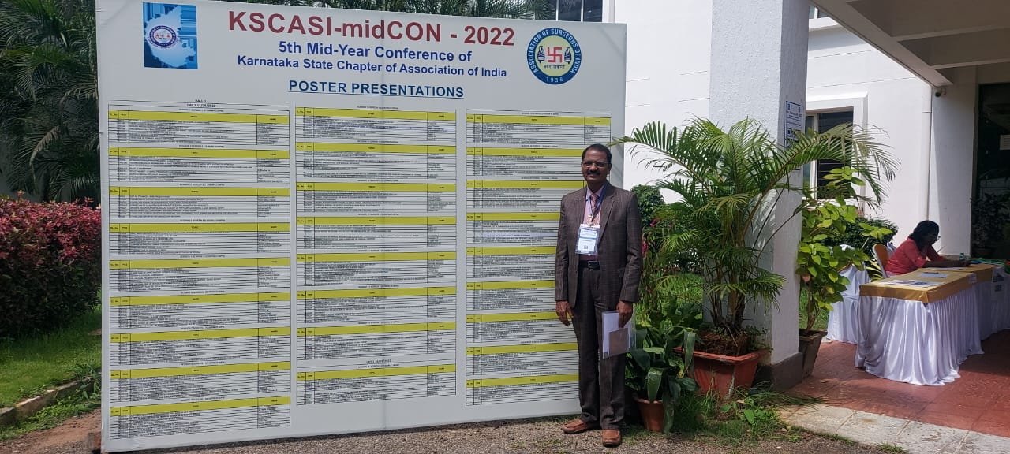
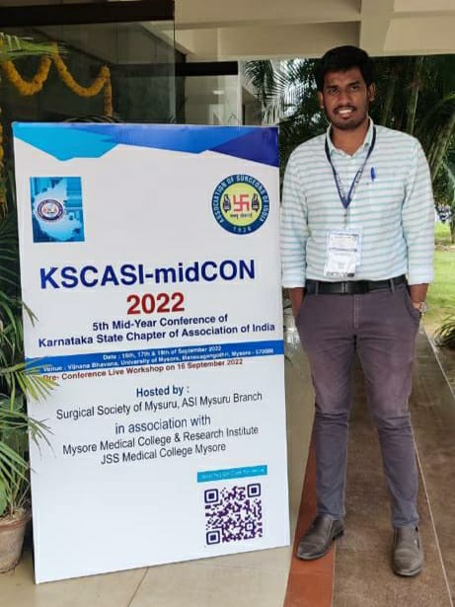
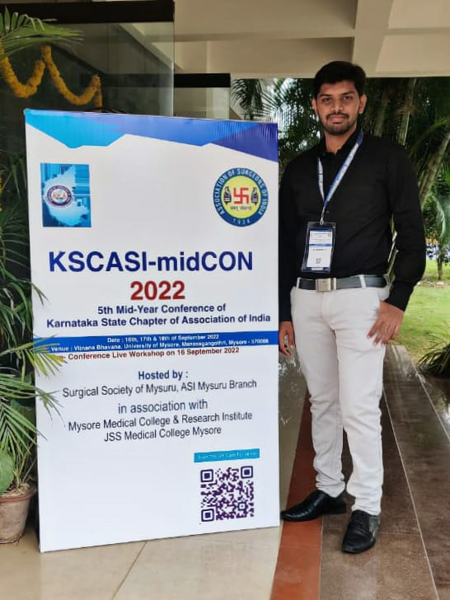
II Jai Sri Gurudev II
Adichunchanagiri Institute of Medical Sciences
(A Constituent College of Adichunchanagiri University)
B.G.Nagara, Nagamangala Taluk - 571448
Department of General Surgery: KSCASI-midCON 2022

Slide 3
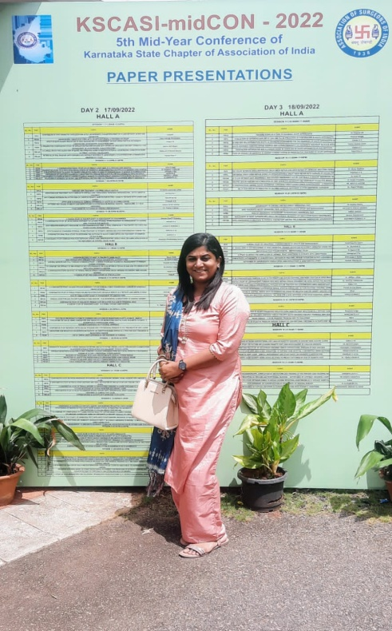
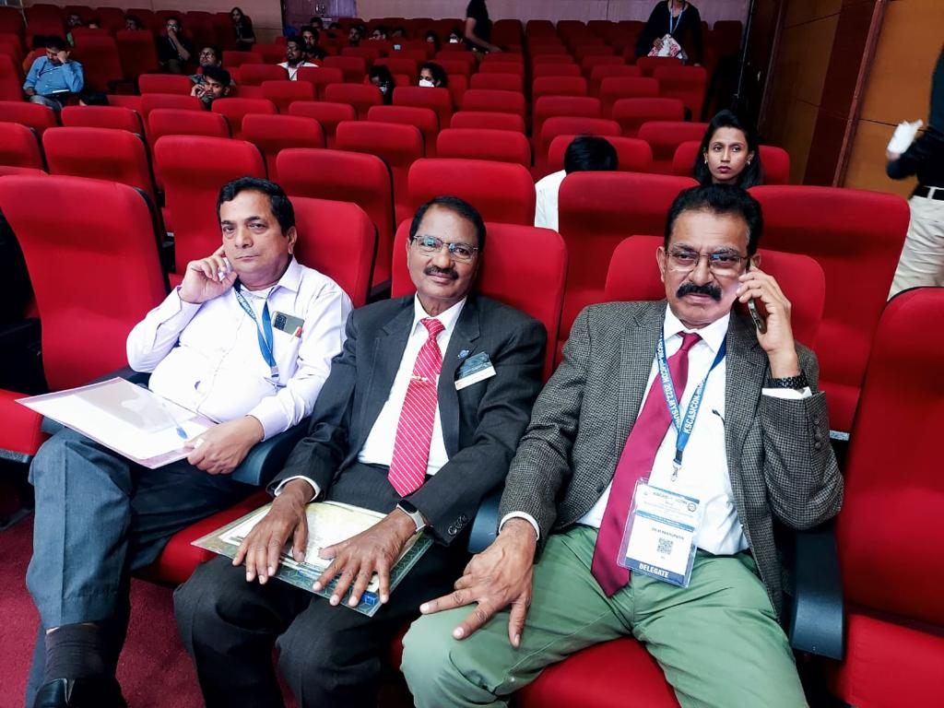
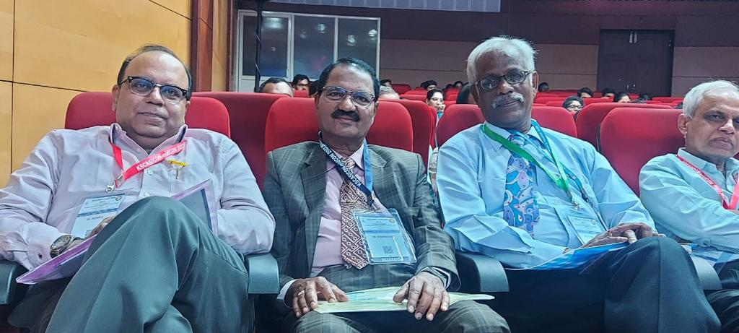
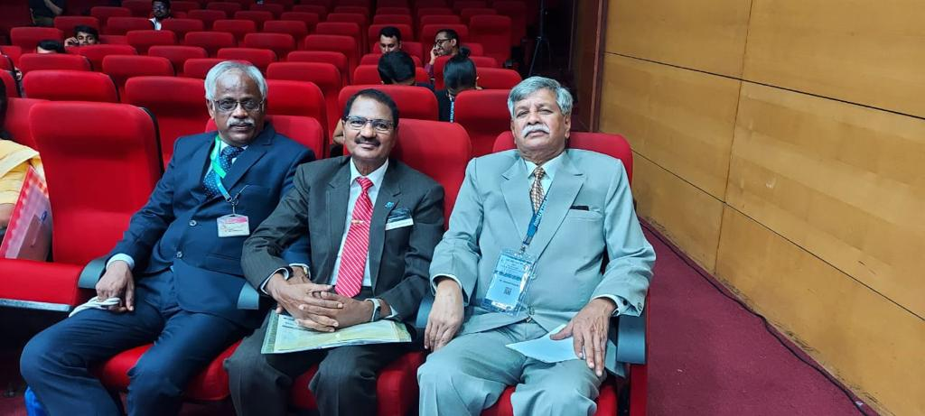
II Jai Sri Gurudev II
Adichunchanagiri Institute of Medical Sciences
(A Constituent College of Adichunchanagiri University)
B.G.Nagara, Nagamangala Taluk - 571448
Department of General Surgery: KSCASI-midCON 2022

